Slide 1
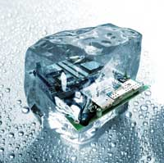
Lua Wireshark Dissectors
So easy, so useful
Kristoffel Pirard
July 1st 2014

Slide 2
Overview
Why and when
Dissector architecture
Example dissector dissected
Demo
What wasn’t covered
Links

Slide 3
Why and when
Network packet decoding
Recorded session
Use case: new protocol, new implementations
Lua => no performance
< 100k packets, < 10MB recording

Slide 4
Dissector Architecture
Table-driven delegation
Key -> Dissector
Dissector -> Table
Notes:
Example: tcp_port
TODO: drawing!

Slide 5
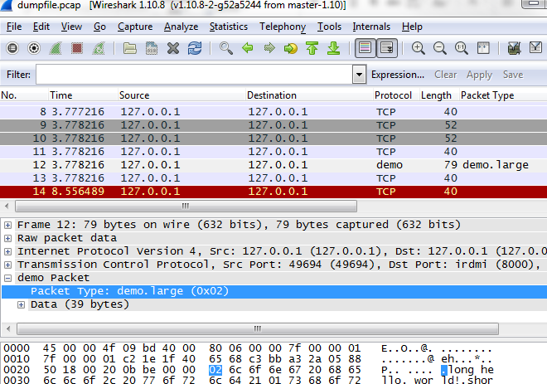
Dissector Architecture
dissector
table
dissector
2014
telnet
2
10
demo
23
http
8000
8080
ftp
2
Notes:
Your dissector gets hold of
vtbuffer
Packet info
Tree structure

Slide 6
Dissector Architecture
Cascading dissector table
demo.short
2014
telnet
0x01
2
10
demo
0x02
23
8000
demo.large
8080
ftp
2

Slide 7
Dissector Architecture
Plugins
Compiled (C)
Dynamic (.so, .dll)
Python (broken on current windows version)
Lua

Slide 8
Dissector Architecture
Entry points (link)
<personal config dir>/init.lua
Wireshark/plugins
cmdline: -X lua_script:xxx.lua

Slide 9
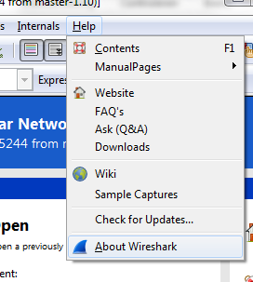
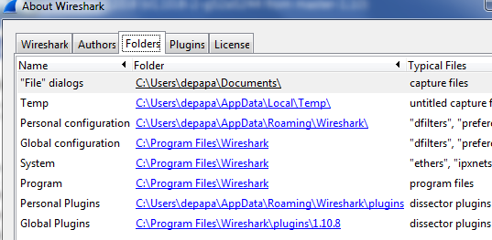
Dissector Architecture
Finding your entry point

Slide 10


Dissecting a dissector
Declare the protocol
Declare the dissector function
Bind to a dissector table

Slide 11
Dissecting a dissector
Declare the fields
Enumeration fields:

Slide 12
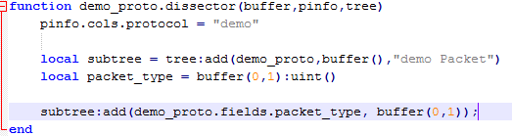
Dissecting a dissector
Populate the tree and info

Slide 13

Dissecting a dissector
Delegating to sub-protocols:
Declare a dissector table
Dispatch in dissector function
Register sub-protocols

Slide 14
What wasn’t covered
Loopback on windows: rawcap needed
Endianness
Conversations, multi-packet messages, …

Slide 15
Demo
… all goes well

Slide 16
Links
Getting started:
http://wiki.wireshark.org/Lua
Details
http://ask.wireshark.org/
http://stackoverflow.com/

Slide 17




www.sioux.eu

